Slide 1
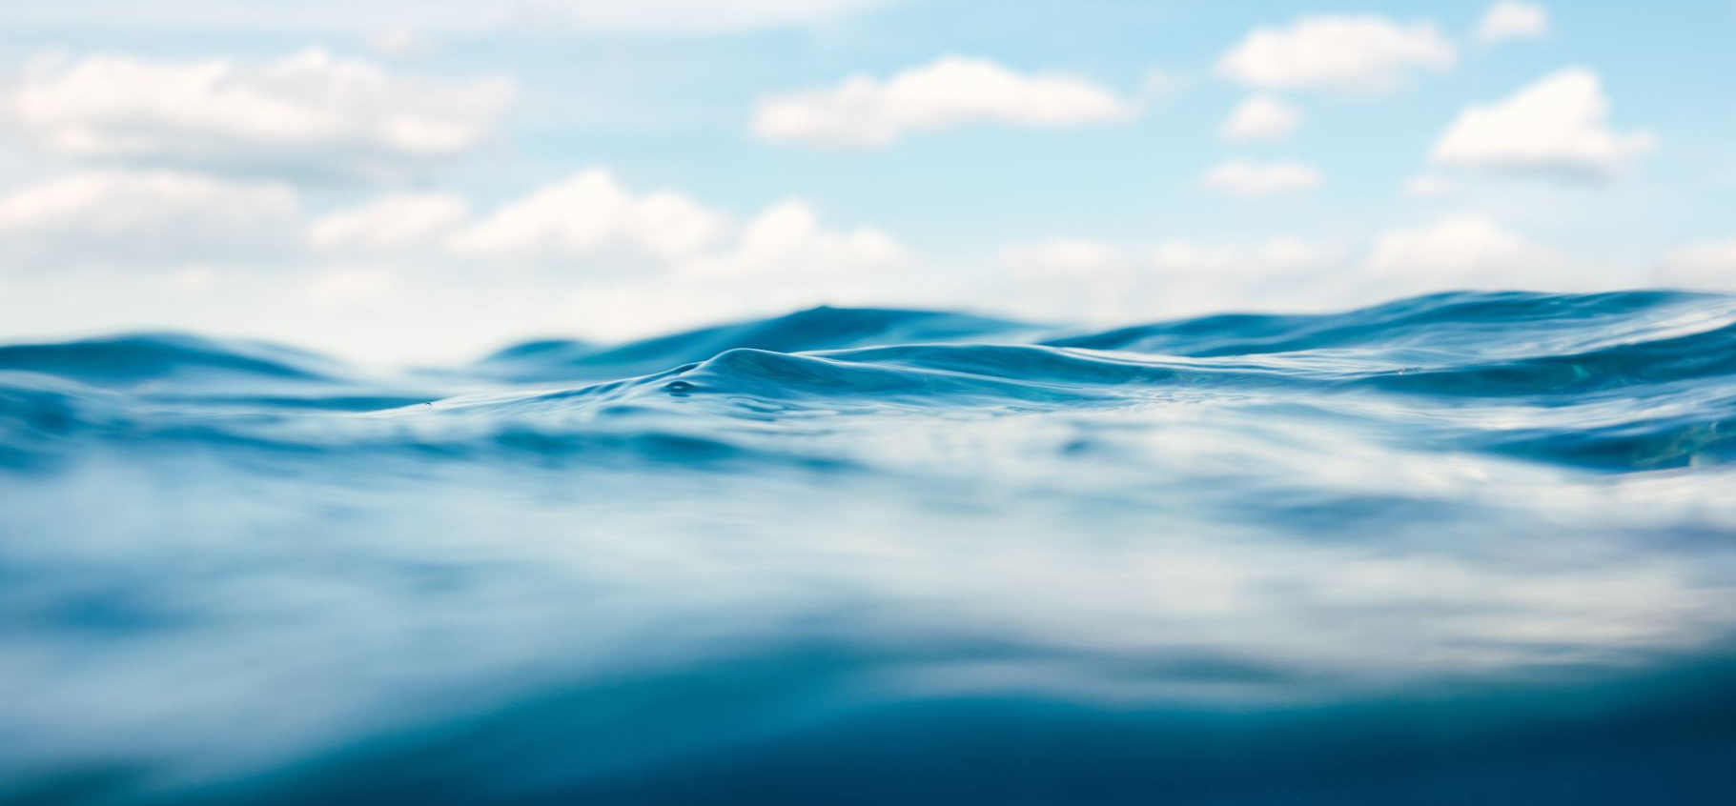
Introducing Sound Speed Variability in a Laboratory Water Tank
Alexandra Hopps, Tracianne B Neilsen
Acoustical Society of America | Chicago, IL | May 2023
Notes:
Undergraduate project

Slide 2
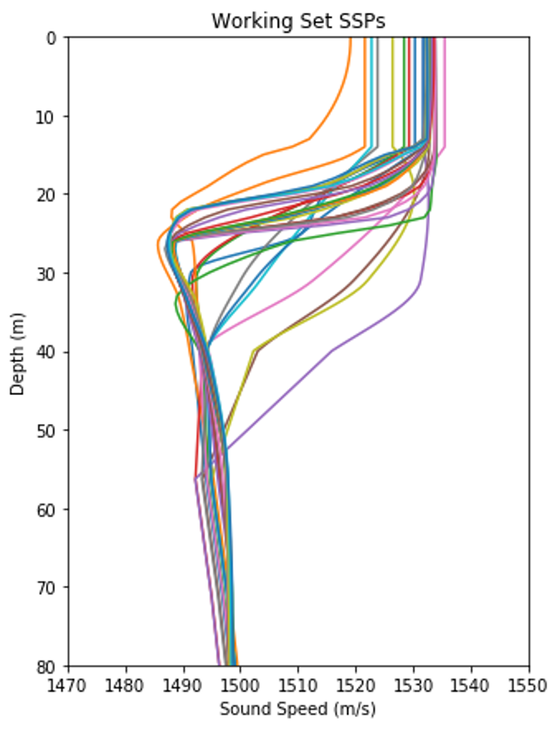
Motivation
Complex ocean environment
Bathymetry
Waves
Seafloor
Sound Speed
Sound speed profiles :
Time of the day
Season
Location
How well mixed the water is
Develop robust machine learning algorithms
Handle variable ocean environments
Notes:
How doe changes in sound speed introduce uncertainty in measurements/variation

Slide 3
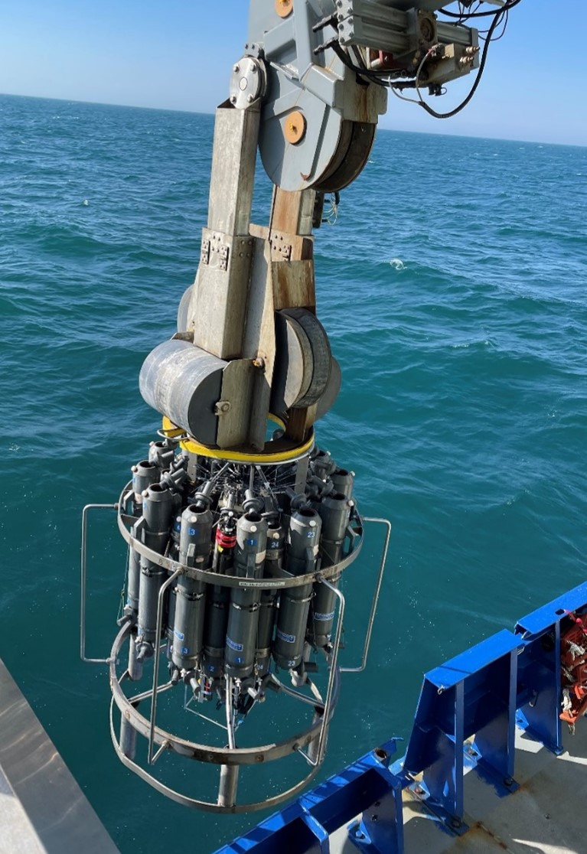
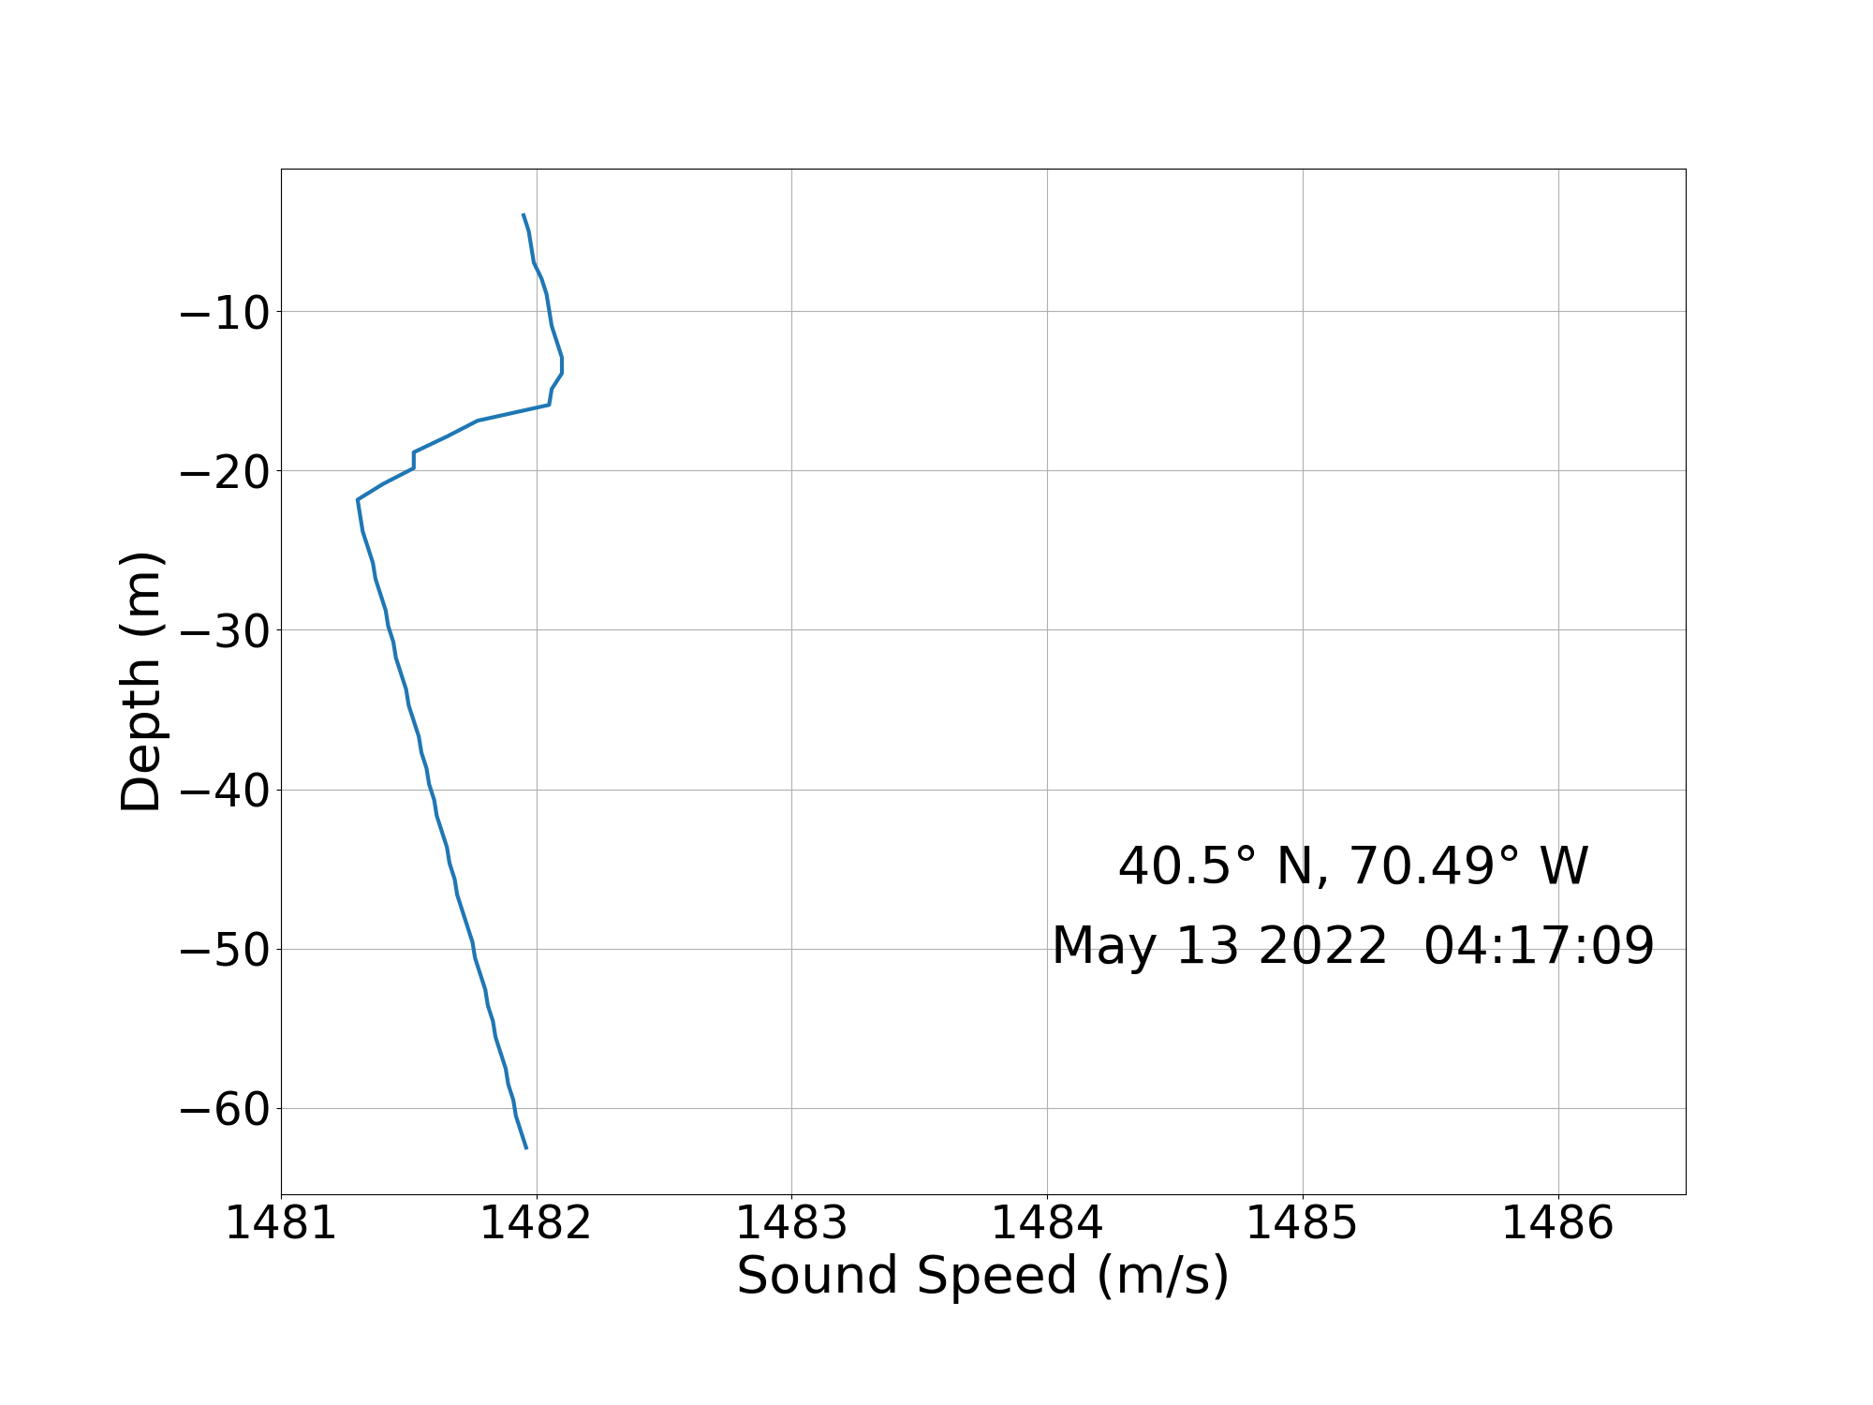
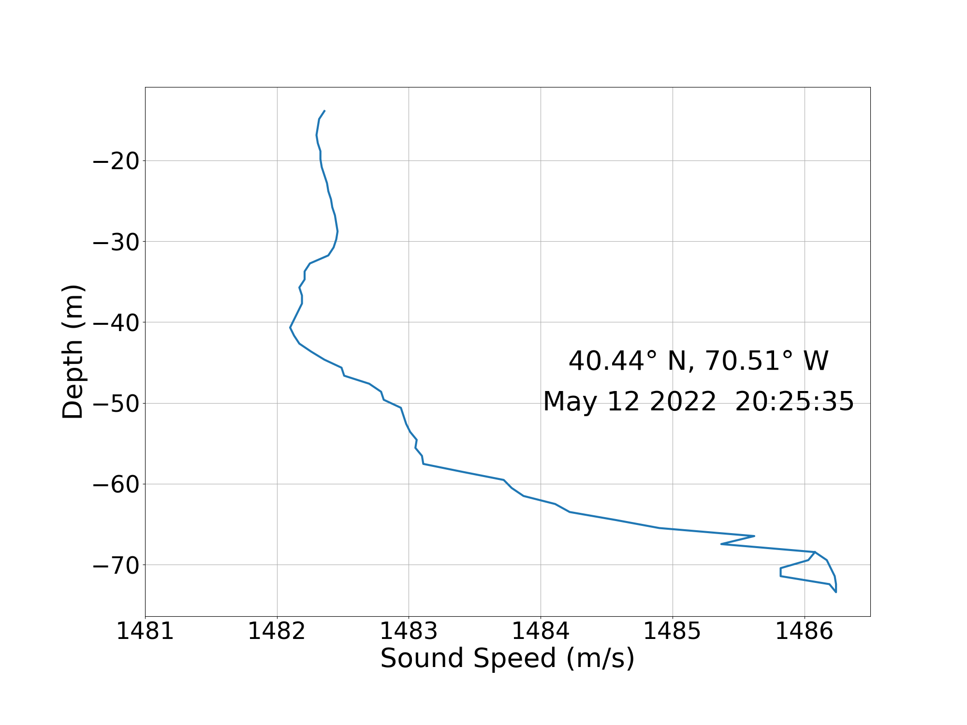
Temperature Variability in the Ocean
Northern SSP New England Mud Patch
Southern SSP New England Mud Patch
Profiles measured aboard the RV Neil Armstrong during the Seabed Characterization Experiment in May 2022.
The northern location was 5.6 km directly north of the southern location.
Notes:
Move shallow ocean stuff to previous slide
Instead of “southern hemisphere” say “from deeper water”
Add image from boat

Slide 4
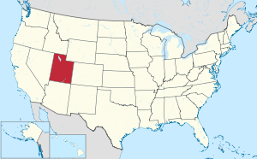
Laboratory Water Tanks
Goal: create an environment for testing machine learning algorithms with environmental variability.
Advantages of Tanks
Greater control of variables
Transducer calibration
Ease of access to large amounts of labeled data required for machine learning
Notes:
Jokeabout being able to do it in utah

Slide 5
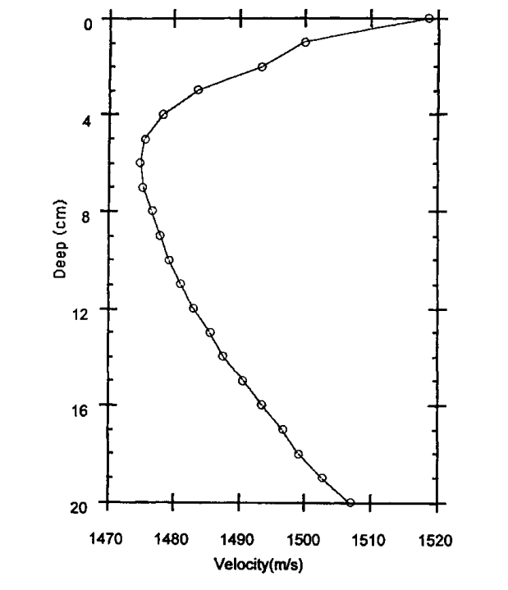
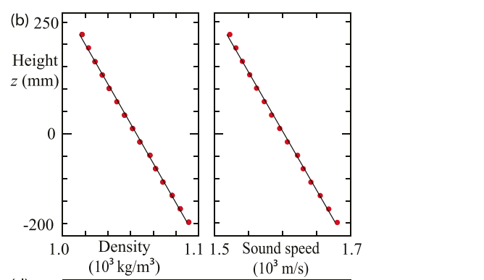
Previous water tanks
Rabau
Layered 7 different fluids to create Tropical Eastern Summer 4000 m profile
Zhang and Swinney
Linearly increased the salinity of the water
L. Zhang and H. L. Swinney, “Sound propagation in a continuously stratified laboratory ocean model,” The Journal of the Acoustical Society of America 141(5), 3186–3189 (2017)
G. Rabau, “Scaled tank experiments of low-frequency propagation in the sofar channel,” Acta Acustica united with Acustica 85(1), 12–17 (1999).
Notes:
Can borrow images for presentation , jong pronunciation

Slide 6
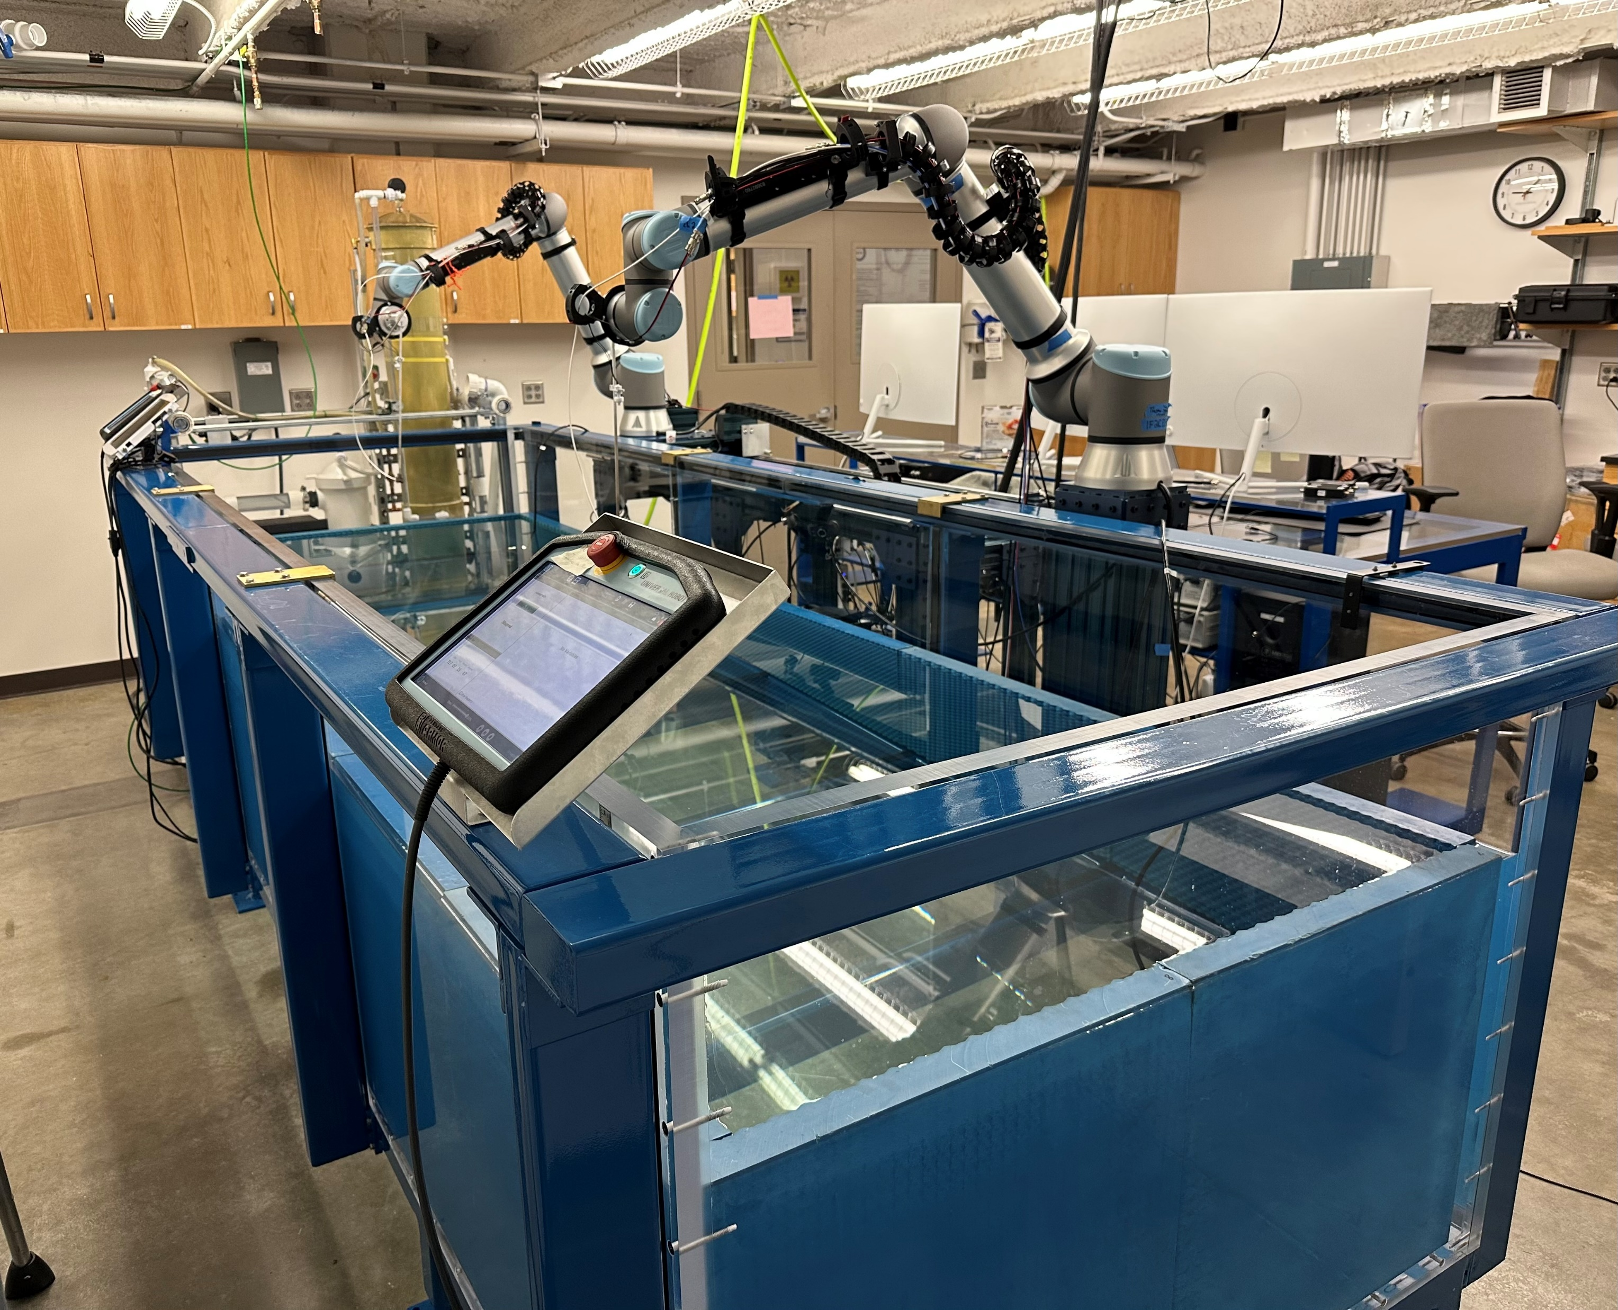
Laboratory Water Tank
3.6 m
Depth = 0.5-0.6 m
Tank filtration system and heater
1.2 m
x
Hydrophones
y
Temperature sensors
Two UR10e robots for moving hydrophones to precise locations
Notes:
Ask corey for better pic

Slide 7
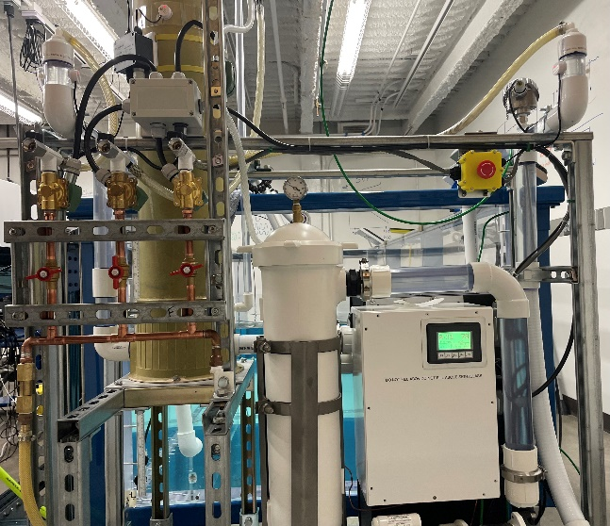
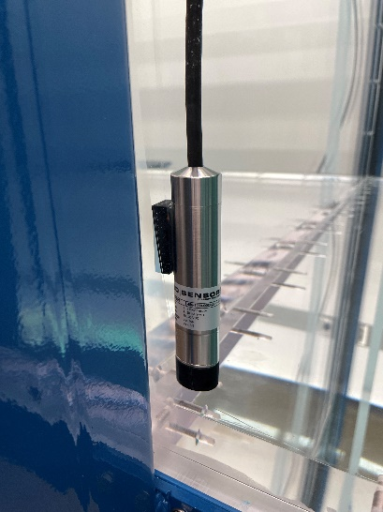
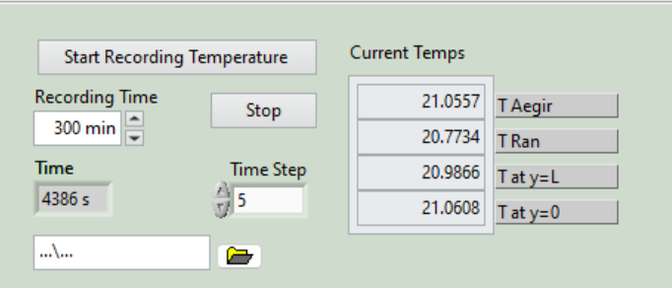
Methods
Enable non-uniform sound speed profiles in a shallow water tank
Vary tank temperature
Measure temperature at various depths
Record data using LabVIEW program

Slide 8
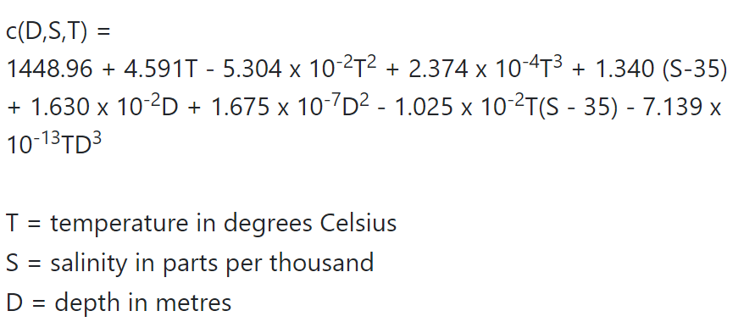
Sound Speed Calculation
Mackenzie equation

Slide 9
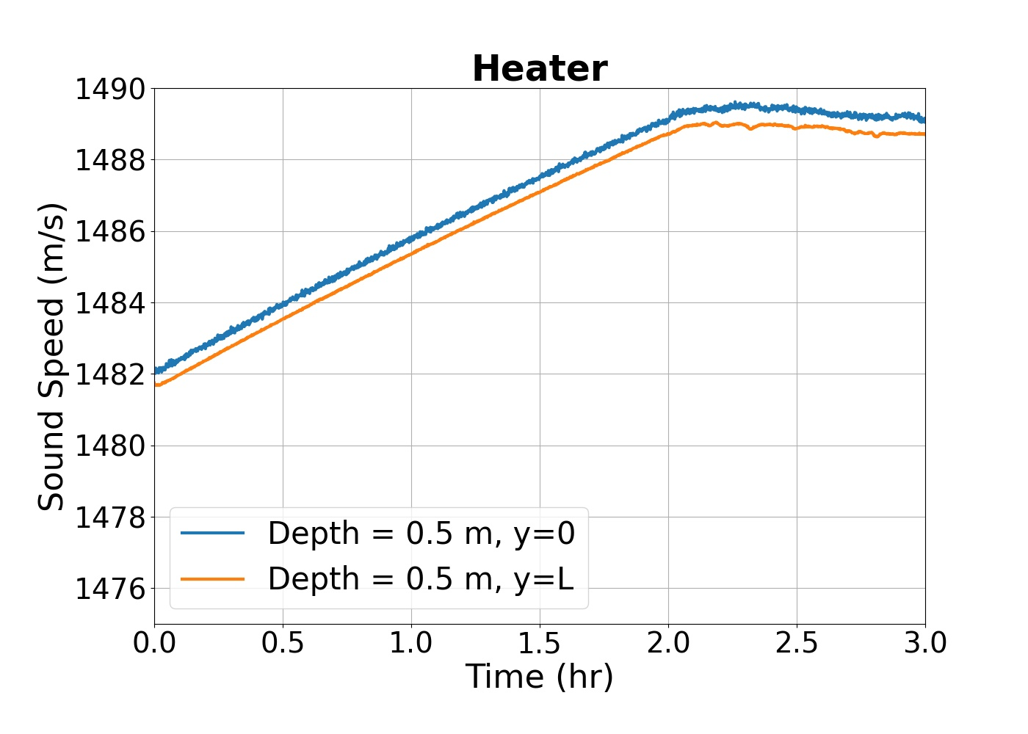
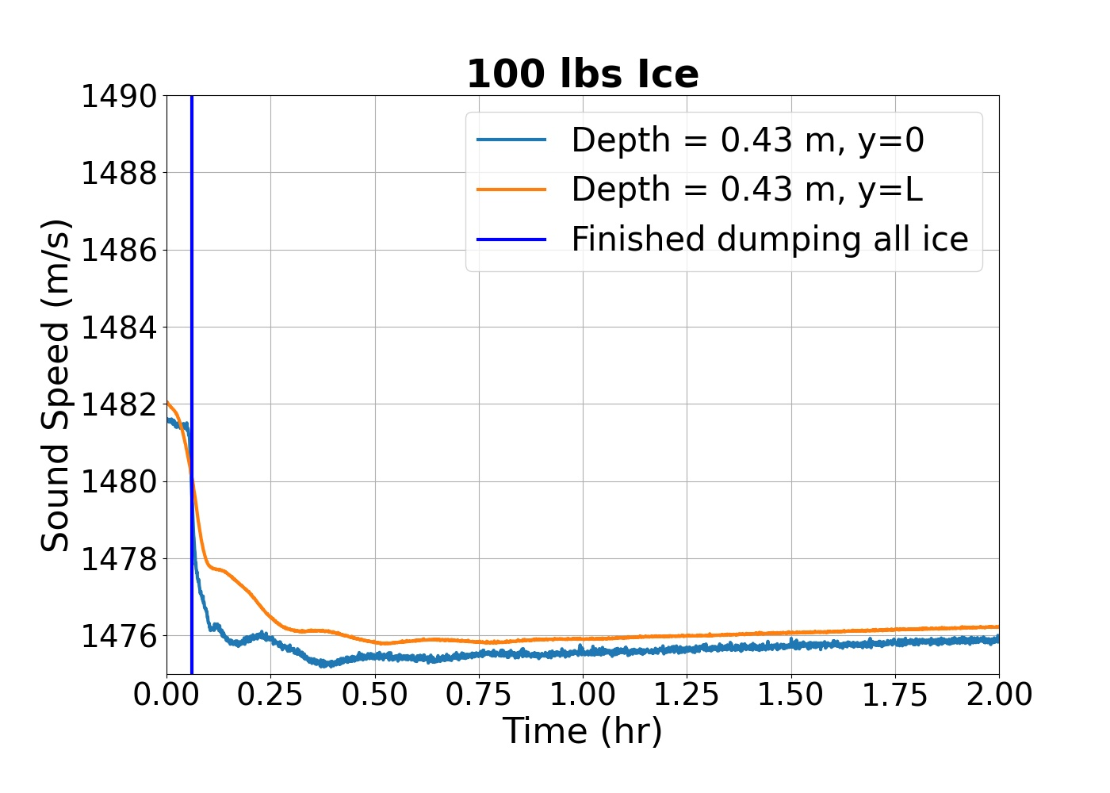
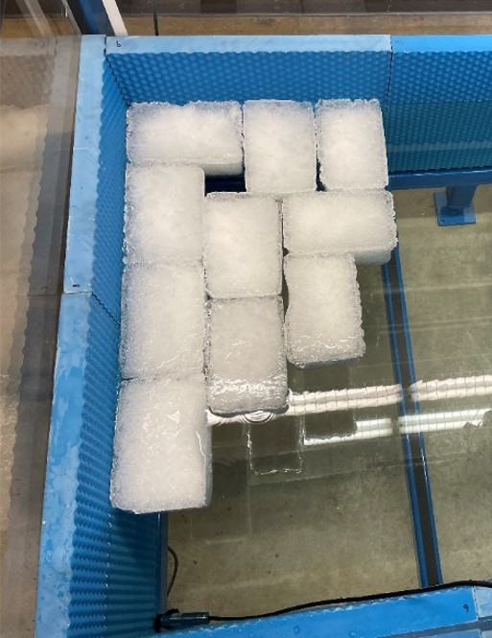
Time-dependent Sound Speed
Sound Speed Range = 14 m/s
Notes:
Fix plot

Slide 10
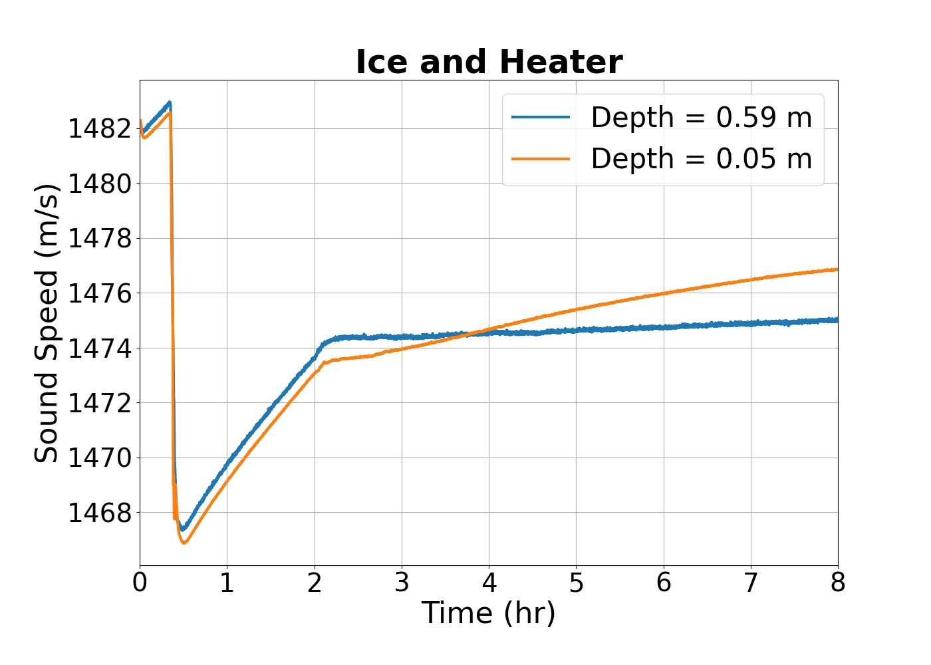
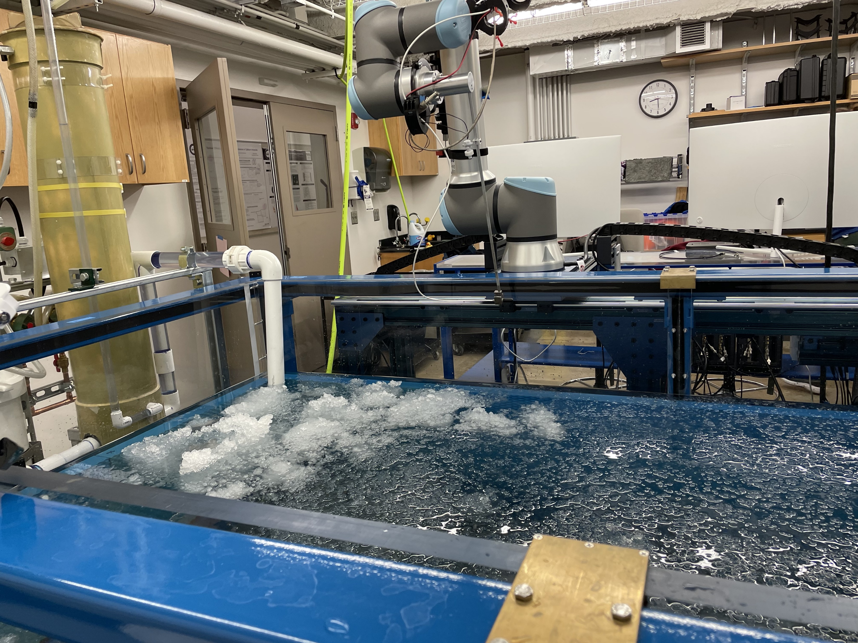
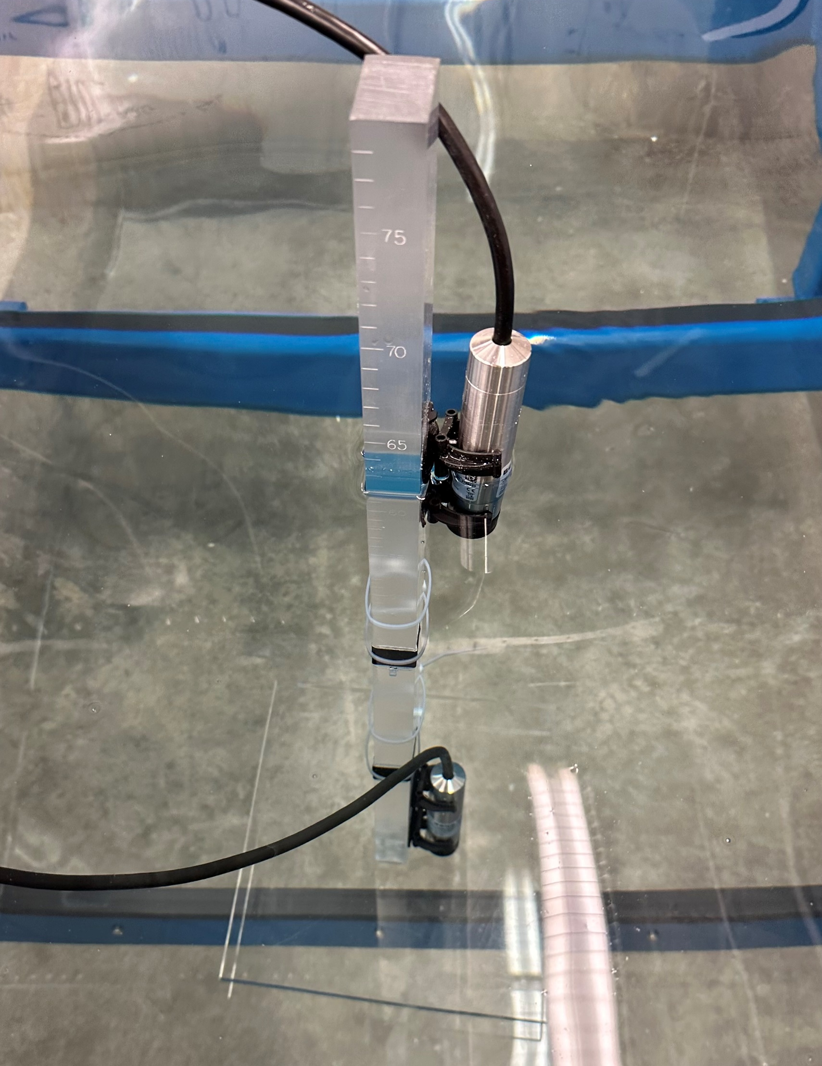
Ice and Heater Sound Speed
Over 300 lbs pebble ice
Ice lowered temperature by 4 ℃
Notes:
We have some ideas why the shallower one got warmer faster but we want to redo the exp 2 more times for consistency, vents above tanks and air blows, building ac

Slide 11
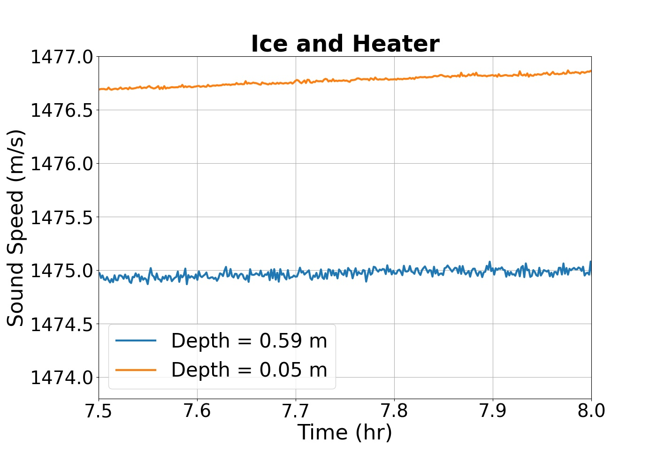
Depth-dependent Sound Speed
1.5 m/s range in sound speed from surface to bottom

Slide 12

Conclusions
Time-dependent sound speed variability:
1476 m/s – 1489 m/s
Depth-dependent variability:
1.5 m/s for 55 cm change in depth
Next Steps
Perform several more depth dependent measurements with heat and ice
Characterize the max sound speed range possible
3pUW3 Dobbs et al.
“Learning source-receiver range in a laboratory tank with variable water temperature”

Slide 13
Acknowledgements
I would like to thank…
Brigham Young University College of Physical and Mathematical Science for funding my research assistantship and travel support
The Office of Naval Research (ONR) for funding the project
The Acoustical Society of America for accepting my abstract and allowing me to present
Jay Clift and Adam Kingsley for collaboration editing the LabVIEW software
Dr. Traci Neilsen for mentorship

Slide 14
Conclusions
Time-dependent sound speed variability:
1476 m/s – 1489 m/s
Depth-dependent variability:
1.5 m/s for 55 cm change in depth
Next Steps
Perform several more depth dependent measurements with heat and ice
Characterize the max sound speed range possible
3pUW3 Dobbs et al.
“Learning source-receiver range in a laboratory tank with variable water temperature”

Slide 15
References
G. Rabau, “Scaled tank experiments of low-frequency propagation in the sofar channel,” Acta Acustica united with Acustica 85(1), 12–17 (1999).
W. A. Kuperman and J. F. Lynch, “Shallow-water acoustics,” Physics Today 57(10), 55–61 (2004).
T. D. Rossing, Springer Handbook of Acoustics (Springer, 2014), pp. 151–152.
L. Zhang and H. L. Swinney, “Sound propagation in a continuously stratified laboratory ocean model,” The Journal of the Acoustical Society of America 141(5), 3186–3189 (2017).
C. T. Vongsawad, T. B. Neilsen, A. D. Kingsley, J. E. Ellsworth, B. E. Anderson, K. N. Terry, C. E. Dobbs, S. E. Hollingsworth, and G. H. Fronk, “Design of an underwater acoustics lab,” in Proceedings of Meetings on Acoustics 181ASA, Acoustical Society of America (2021), Vol. 45, p. 070005.

Slide 16
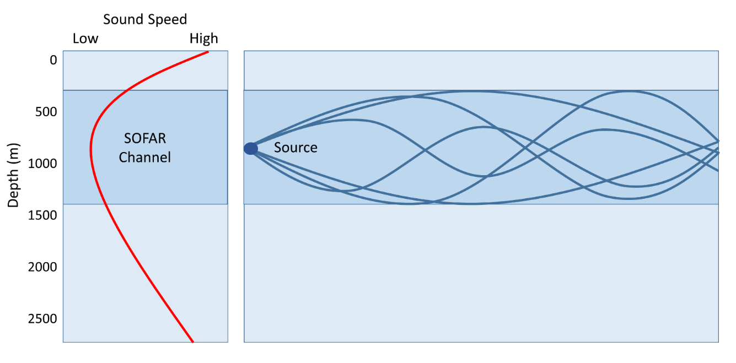
Temperature Variability in the Ocean
Deep Ocean
Sound waves tend to bend towards the depth of minimum sound speed
Minimal energy loss allows sound waves to travel greater distances
Photo credit: https://rwu.pressbooks.pub/webboceanography/chapter/6-4-sound/

